Slide 1

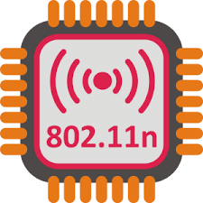
CS 118: Local Area Networks, Ethernet and 802.11
George Varghese
October 15, 2024

Slide 2
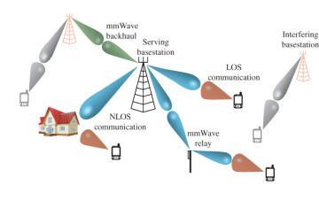
Imagine you work for Qualcomm on their new mm wave local area network and you feel the design team is ignoring lessons from Ethernet collision detection. So its worth understanding not just how but why . . .
Notes:
So imagine you work for Google’s Loon group that is rethinking communication for the developing world using balloons.

Slide 3

Data Link Sublayers
Point−to−point Links (2 nodes)
(e.g., HDLC, Frame Relay)
Broadcast Links (>= 2 nodes)
(e.g., Ethernet, Token Ring)
Frames
Frames
ERROR RECOVERY
(OPTIONAL)
MULTIPLEXING
MEDIA ACCESS
ERROR DETECTION
ERROR DETECTION
FRAMING
FRAMING
Bits
Bits
MOVING ON TO MEDIA ACCESS, MANY SENDERS AND RECEIVERS ON SAME LINK: e.g., Ethernet, 802.11

Slide 4


Big Transition this class
From 1 sender, 1 receiver (e.g., fiber) to . .
Sender
Receiver
Multiple senders, receivers (e.g., Ethernet)
S 3
S 2
S 1
S 4
New problem: how to share a link (MAC)

Slide 5
A Rose by any other Name
Inherently sequential. Link shared among multiple senders. Also Known as:
Multiaccess links because there are multiple nodes that may simultaneously access link.
Broadcast links because every transmission can be heard by all other stations.
Local Area Networks or LANs because the geographical area serviced by a LAN is local and small – from 1-10 Kms, covering an office, a building, or at most a campus.

Slide 6
WHY LANS
Cost: Connect up all computers in a building, office, campus. 200-1000 users. Saves wiring costs to share one wire (or the air waves, no dedicated air waves).
Bandwidth: Provides high bandwidth and low error rates for local group of users. Worth it because most high-bandwidth distributed computing (e.g., file servers etc.) has acess locality.
Statistical Multiplexing: Time division multiplexing not a good idea when user traffic is bursty as data is. Bursty = high peak/average ratio. Each user gets access to entire LAN bandwidth when other users are idle. As more users are added, they share the bandwidth

Slide 7





How might you share a Xerox Machine?
By time slots? No collisions, but wasteful!
John: 10 – 11.00 am
Bob: 12 – 1.00 am
Ron: 11 – 12.00 am
Meg: 12 – 1.00 am

Slide 8
How would you share a Xerox Machine?
Just show up but sort out collisions
Ron: waits for John
We call this statistical multiplexing, better latency & throughput in common case: what Ethernet does

Slide 9
Statistical versus Strict Multiplexing
Strict multiplexing: TDM or FDM where a user is given a fixed allocation regardless of whether the user has data to send or not.
Bursty: traffic has a high peak/average ratio.
Analysis: gives each user B/N , where N is the number of possible sources; stat multiplexing attempts to give each user, B/x, where x is the number of busy users. N large (100 -1000) while x is small (1-10).
Example: Suppose 100 users each transfer a 125 kbyte file every 2 hours. At 10 Mbps, a 125 kbyte file takes 0.1 seconds to transmit. At 0.1 Mbps, file takes 10 seconds to transfer.

Slide 10
ALOHA
UNSLOTTED ALOHA
SLOTTED ALOHA
2T
T
Ethernet Predecessor: Multiple ground stations in various parts of Hawai.
Problem: Couldn’t detect collisions or sense when channel was busy. Similar problems in 802.11
Slotted Aloha: reduces vulnerable period by half but requires a common clock

Slide 11

BOB METCALFE – ETHERNET
PhD Thesis at Harvard invents CSMA/CD
Goes to Xerox PARC and invents Ethernet
Founds 3Com to commercialize Ethernet
Metcalfe’s Law, Internet Hall of Fame
Turing Award 2023, came to 118!
More refined analysis of ALOHA that inspires him when he

Slide 12
Detect collisions while sending
Metcalfe knew about Aloha. He knew he could do better because of the smaller distance.
1500 byte frame involved in a collision. Ethernet aborts transmission after 64 bytes. Aloha will send the entire 1500 bytes and detect when ack is not received. Better for large frames, and large frame sizes allow efficiency.
No recovery from frame corruption. (1 in million). However, collisions are frequent. Semi-reliable: detect collisions and retransmit in hardware.

Slide 13
What is a collision?
The notion of a collision is nuanced
Definition: A station A detects a collision if two or more signals from different senders coexist at A
Like relativity: Different stations detect collisions at different times. Worse, without care some stations may detect collisions and some may not
Need mechanisms: Want to convert relativity to universality, so that if receiver detects a collision so does sender, so sender can retransmit. One big mechanism is forcing a minimum packet size
Waves not balls: On Ethernet and 802.11 Frames are sent as waves that pass through each other, and don’t collide and rebound like balls!
Sender 1
Sender 2

Slide 14
Without Min Packet Size
A
D
C
B
Short
Frame
•
•
Clean
COLLISION
A transmits to C and B transmits to D, if A sends a short frame C will detect a collision and A will not. So A won’t retransmit

Slide 15
With Min Packet Size
A
D
C
B
Min Packet
Size
Frame
•
•
COLLISION
COLLISION
A transmits to C and B transmits to D, if A sends a “long enough” frame, C will detect a collision and A will too. So A will retransmit
Question 1 for breakout: If the transmission speed is 10 Mbit/sec and the max propagation delay is 25.6 usec what should the min Packet size be?

Slide 16
It’s subtler than you might think
The notion of a collision is nuanced
Definition: A station A detects a collision if two or more signals from different senders coexist at A
Like relativity: Different stations detect collisions at different times. Worse, without care some stations may detect collisions and some may not
Need mechanisms: Want to convert relativity to universality, so that if receiver detects a collision so does sender, so sender can retransmit. One big mechanism is forcing a minimum packet size
Waves not balls: On Ethernet and 802.11 Frames are sent as waves that pass through each other, and don’t collide and rebound like balls!
Sender 1
Sender 2

Slide 17
Without Min Packet Size
A
D
C
B
Short
Frame
•
•
Clean
COLLISION
A transmits to C and B transmits to D, if A sends a short frame C will detect a collision and A will not. So A won’t retransmit

Slide 18
With Min Packet Size
A
D
C
B
Min Packet
Size
Frame
•
•
COLLISION
COLLISION
A transmits to C and B transmits to D, if A sends a “long enough” frame, C will detect a collision and A will too. So A will retransmit
Question 2: If the transmission speed is 10 Mbit/sec and the max propagation delay is 25.6 usec what should the min Packet size be?

Slide 19
Question 2
Case 1: Consider 2 colliders. One should wait 1 slot and the other 0. Can approximate by tossing a coin.
Case 2: Consider 16 colliders. Ordinary coin-tossing does not work. Pick random numbers from 1 to 16.
But stations don’t know in advance which Case (or others) will happen!
Can you think of a clever way to work around this. Hint: think of how much you wait after a collision as a dynamic variable not a static one..

Slide 20
Answers
Question 1: The min packet size is the “pipe”size. Round trip delay * Transmission Speed = 10 Mbs * 51,2 = 512 bits = 64 bytes.
Question 2: Ethernet does Binary exponential backoff. After attempt A, each station randomly picks a random number of of slots between 0 and 2^{A} – 1. A slot is 51.2 usec. So after one collision pick 0 or 1 slot, after 2: 0, 1, 2., or 3 slots, After 3 collisions: 0., 1., 2, 3, 4, 5, 6, or 7 slots
Both ideas are now classical

Slide 21
ETHERNET
Three main mechanisms: :
Carrier sense and deference: No point transmitting when someone else is speaking
Collision Detection: Stop frame (< 1500 bytes) when before 64 bytes you detect a collision.
Exponential Backoff: Collisions very frequent, so must retransmit. Random backoff avoids synchronized collisions. Dynamically adjust to number of colliders.

Slide 22
ETHERNET CONTINUED
Smaller mechanism to make main ideas work:
Slot time: = 2T, T is 1-way propagation delay limited to 51.2 usec = 64 bit times at 10 Mbps: maximum delay to detect a collision.
Minimum packet size: 64 bytes to avoid finishing transmission before collision is detected. Add pad if needed.
Jam: transmit small number of bits after you detect a collision to ensure that other transmitters also detect collision.
Collision detection: One way is to use Manchester with average DC level per bit. Collision detection by detecting increased voltage level. Better ways today.

Slide 23
Ethernet Header
01010111 preamble | Dest (6) | Source (6) | Length (2) | Data | Pad | CRC
Total Frame length 64<=L<=1500

Slide 24
Why Jam?
A
B
Short
Frame
jam to
•
•
ensure
"width"
Clean
of collision
COLLISION

Slide 25
Ethernet Implementation Details
Limited distance (2.5 km). 500 m wires. 4 repeaters.
Thin wire, Thick wire
Repeaters/Hubs: important device, reads in a bit and writes out a bit on other side, boosting signal strength.
Physical Topology is a star or tree.

Slide 26
Cost of statistical muxing in Ethernet
If distance goes up by a factor of 10 or speed, then what happens to min packet size? Why is it wasteful?
100 Mbps Ethernet proposal has only 200 m extent.
Gigabit Ethernet? Span too small (2 m? What kind of LAN is that?) Instead, replace shared wire with point to point links and hubs with switches.
The cost of statistical multiplexing is why Ethernet is limited to Local Area Networks!

Slide 27
From CSMA/CD to switching
R
S
A
•
•
HUB
HUB
B
If A talks to R at same time as B talks to S there is
a collision. True for 10 and 100 M Ethernet.
R
S
A
•
•
SWITCH
SWITCH
B
A can talk to R at same time as B talks to S with
no collision. Switch buffers and allows parallel
connections. True for Gigabit Ethernet

Slide 28
So you are telling me that
Gigabit Ethernet no longer uses CSMA/CD
So why do we do study the stuff?
Because similar Media Access protocols are used especially in wireless and 802.11 as we now describe

Slide 29
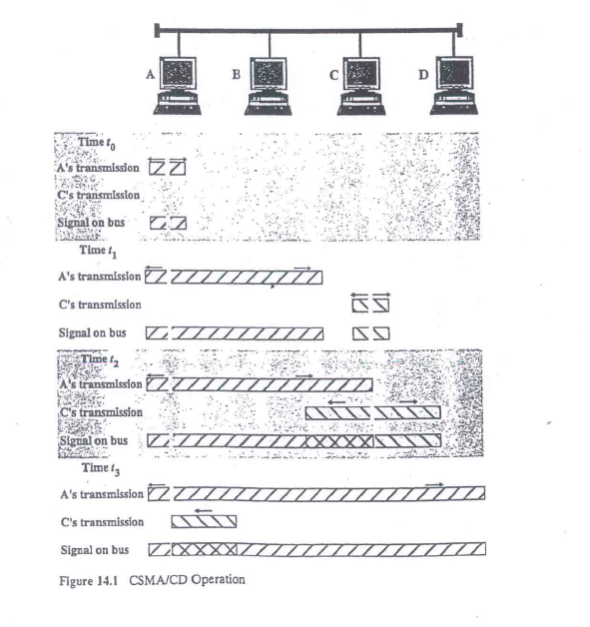
From a textbook by Richard Stallings

Slide 30
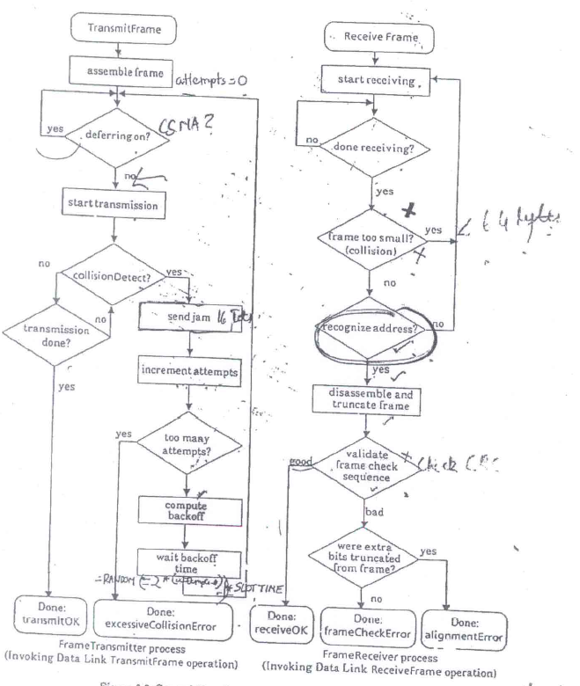
FROM EARLIEST DEC-XEROX-INTEL ETHERNET SPEC

Slide 31
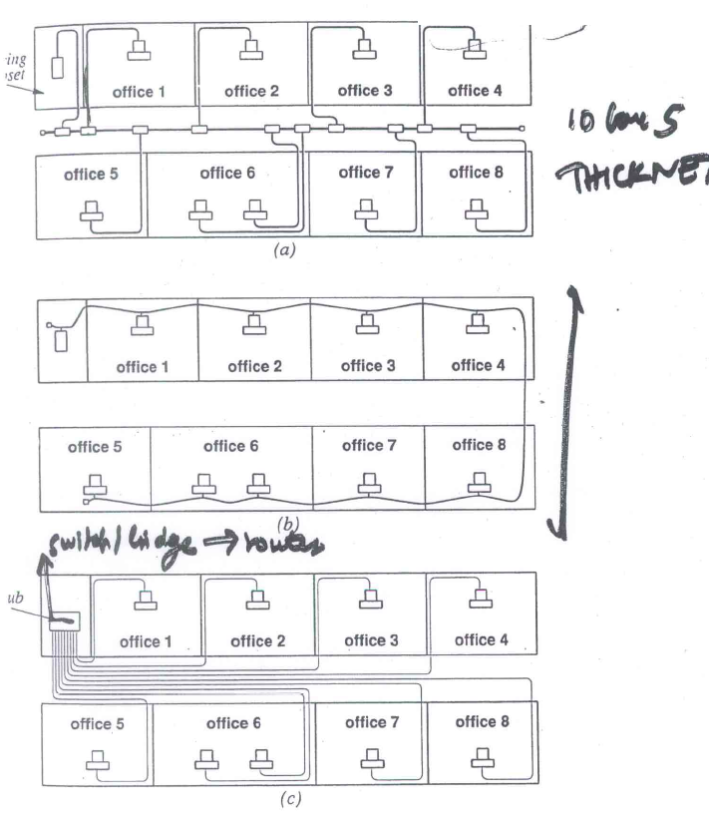
HOW ETHERNET CAN BE WIRED (From STALLINGS)
ORIGINAL COAX WIRING
TWISTED PAIR,
NO HUB
TWISTED PAIR,
WITH A HUB

Slide 32
802.11
George Varghese
(slides from A. Snoeren, UCSD)

Slide 33
802.11 Layering
fixed
terminal
•
•
infrastructure
network
application
application
TCP
access point
TCP
IP
IP
LLC
LLC
LLC
802.11 MAC
802.11 MAC
802.3 MAC
802.3 MAC
802.11 PHY
802.11 PHY
802.3 PHY
802.3 PHY

Slide 34
WLAN: IEEE 802.11b
Data rate
1, 2, 5.5, 11 Mbit/s
User data rate max. approx. 6 Mbit/s
Transmission range
300m outdoor, 30m indoor
Max. data rate ~10m indoor
Frequency
Free 2.4 GHz ISM-band

Slide 35
Physical Channels
12 channels available for use in the US
Each channel is 22 MHz wide
Only 3 orthogonal channels
Using any others causes interference
US (FCC)/Canada (IC)
channel 1
channel 6
channel 11
2400
2412
2437
2462
2483.5
22 MHz
[MHz]

Slide 36
Carrier Sense Multiple Access
CSMA: listen before transmit:
If channel sensed idle: transmit entire pkt
If channel sensed busy, defer transmission

Slide 37
Hidden Terminal Problem
A
B
C
B can communicate with both A and C
A and C cannot hear each other – not a single shared channel
Problem
When A transmits to B, C cannot detect the transmission using the carrier sense mechanism
If C transmits, collision will occur at node B
Solution:
Hidden sender C needs to defer
Notes:
Carrier sense is useful but not all interfering senders can be carrier sensed. This results in a problem, commonly called hidden terminal.

Slide 38
RTS/CTS (MACA)
A
B
C
When A wants to send a packet to B, A first sends a Request-to-Send (RTS) to B
On receiving RTS, B responds by sending Clear-to-Send (CTS), provided that A is able to receive the packet
When C overhears a CTS, it keeps quiet for the duration of the transfer
Transfer duration is included in both RTS and CTS

Slide 39
Backoff Interval
Problem: With many contending nodes, RTS packets will frequently collide
Solution: When transmitting a packet, choose a backoff interval in the range [0, CW]. CW is contention window
Wait the length of the interval when medium is idle
Count-down is suspended if medium busy
Transmit when backoff interval reaches 0
Need to adjust CW as contention varies. Similar in spirit to Ethernet backoff

Slide 40
Non-symmetric ranges
DATA
A
B
C
D
E
F
Transmit “range”

Slide 41
802.11 COLLISION AVOIDANCE EXAMPLE
RTS = Request-to-Send
RTS
A
B
C
D
E
F
Pretending a circular range

Slide 42
IEEE 802.11
NAV = remaining duration to keep quiet
RTS = Request-to-Send
RTS
A
B
C
D
E
F
NAV = 10

Slide 43
CTS = Clear-to-Send
CTS
A
B
C
D
E
F

Slide 44
CTS = Clear-to-Send
CTS
A
B
C
D
E
F
NAV = 8

Slide 45
DATA packet follows CTS. Successful data reception acknowledged using ACK.
DATA
A
B
C
D
E
F

Slide 46
Reserved area
ACK
A
B
C
D
E
F

Slide 47
Concepts/Conclusions
Statistical Multiplexing is a big idea
Importance of Pipe-size or bandwidth delay product in determining efficiency.
Logical versus physical topology. 10 M Ethernet is logically a bus but physically a star
Ethernet ideas mostly gone in Gigabit Ethernet but some ideas like CSMA live on in 802.11. Also,10-100 Mbps Ethernet is still used

Slide 48

EPILOG: POINCARE ON CREATIVITY
“I left Caen, where I was living, to go on a geological . . . travel made me forget my mathematical work . . . we entered an omnibus . .. At the moment when I put my foot on the step, the idea came to me, without anything in my former thoughts seeming to have paved the way for it, that the transformations . . [for] Fuchsian functions were identical with those of non-Euclidean geometry. I did not verify the idea . . but I felt a perfect certainty. On my return to Caen, I verified the result at my leisure.”
― Henri Poincaré.

